Slide 1

EPSA Governance Committee Survey
Ray Duch
August 4, 2023

Slide 2
Survey Described

Slide 3
EPSA 2023 Annual Conference Survey
Conference Registered: 1100
Survey Responses: 520 – a response rate of 47%
Period of survey June 2023

Slide 4

Conference Delegate Profile

Slide 5
Conference Delegate Profile Highlights
Nation of work: 25% Germany; 18% UK; 15% USA
Nationality: 28% German; 15% American; 8% Spanish; 7% Italian
Less than one-third senior faculty
Just under 50% of delegates have attended at most two EPSA meetings
Virtually all delegates are from universities

Slide 6
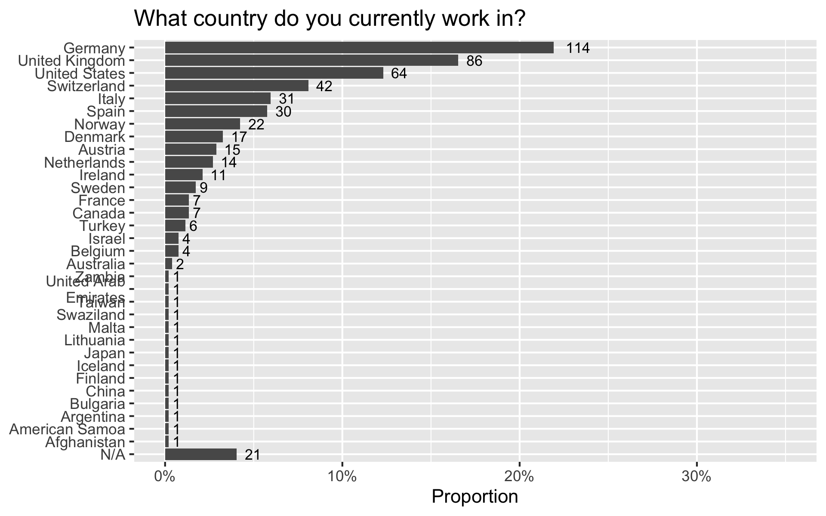

Slide 7
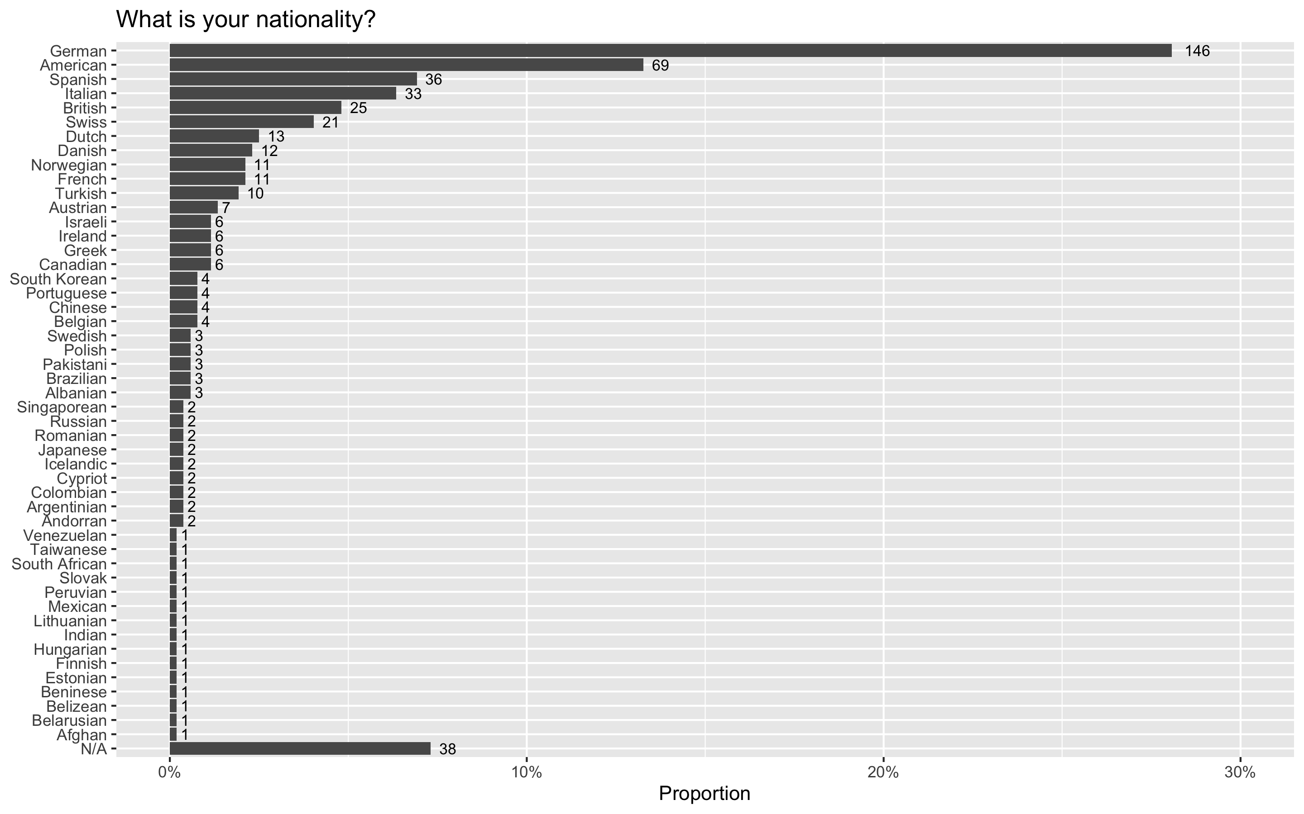

Slide 8
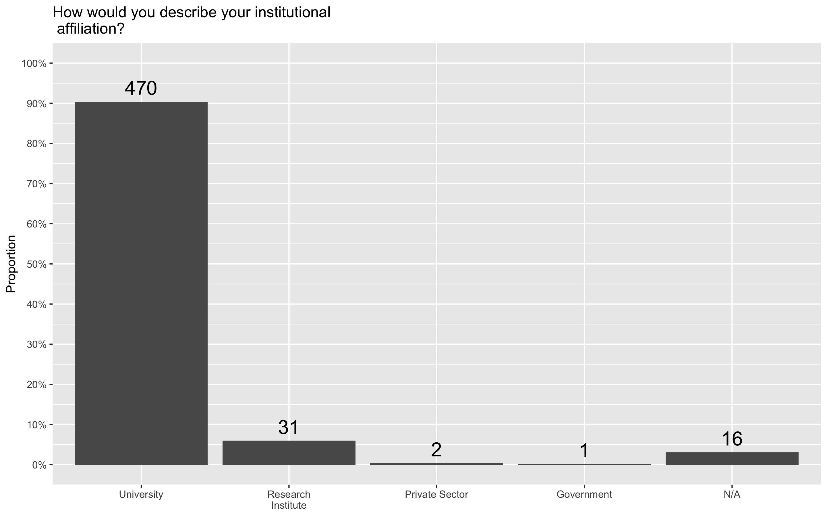
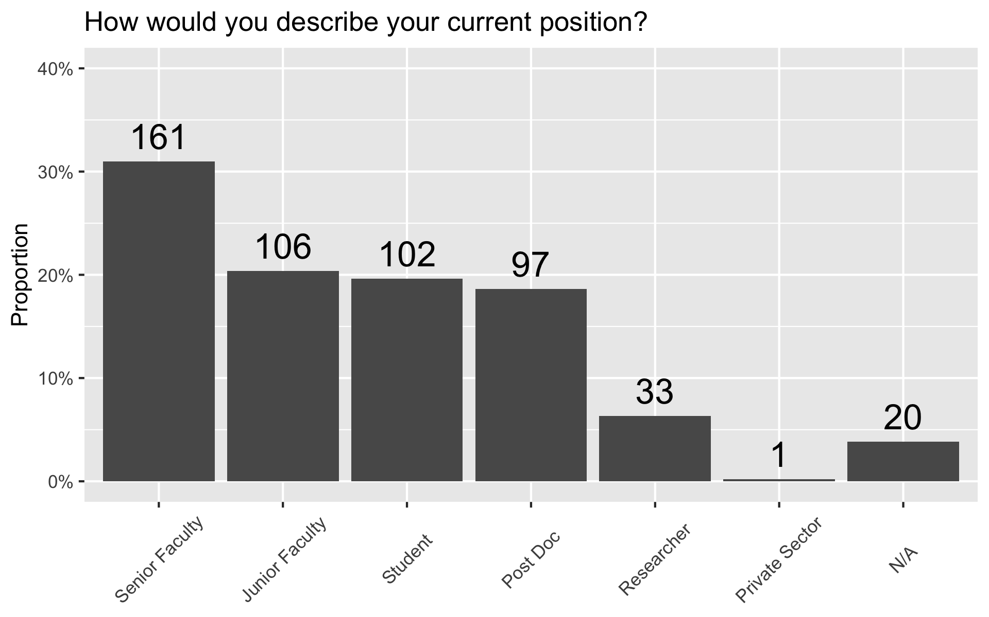
Institutional Affiliation and Status

Slide 9
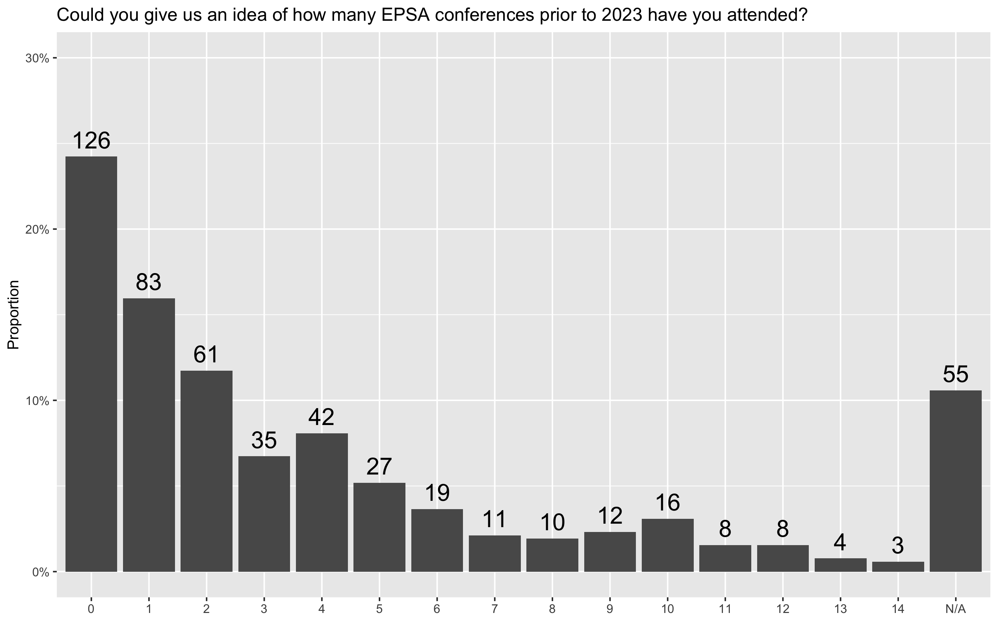
Conference Attendance

Slide 10

Delegate Evaluations of EPSA

Slide 11
Delegate Evaluation Highlights
EPSA top ranked conference: mean score = 7 (0-10)
EPSA represent political science interests: mean score = 6 (0-10)
EPSA Council represents EPSA members: mean score = 6 (0-10)
Just under 50% of delegates have attended at most two EPSA meetings
Virtually all delegates are from universities

Slide 12
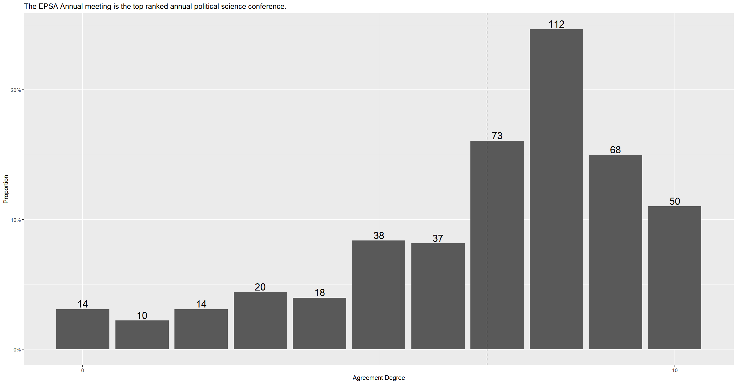
Overall Evaluation of EPSA

Slide 13
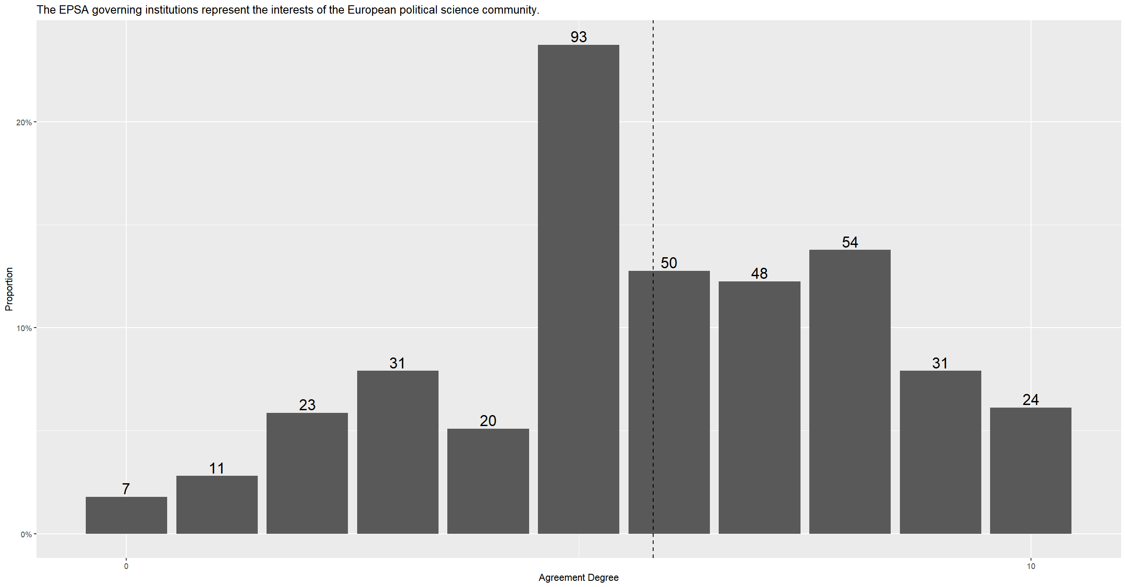
EPSA Governing Institutions Represent

Slide 14
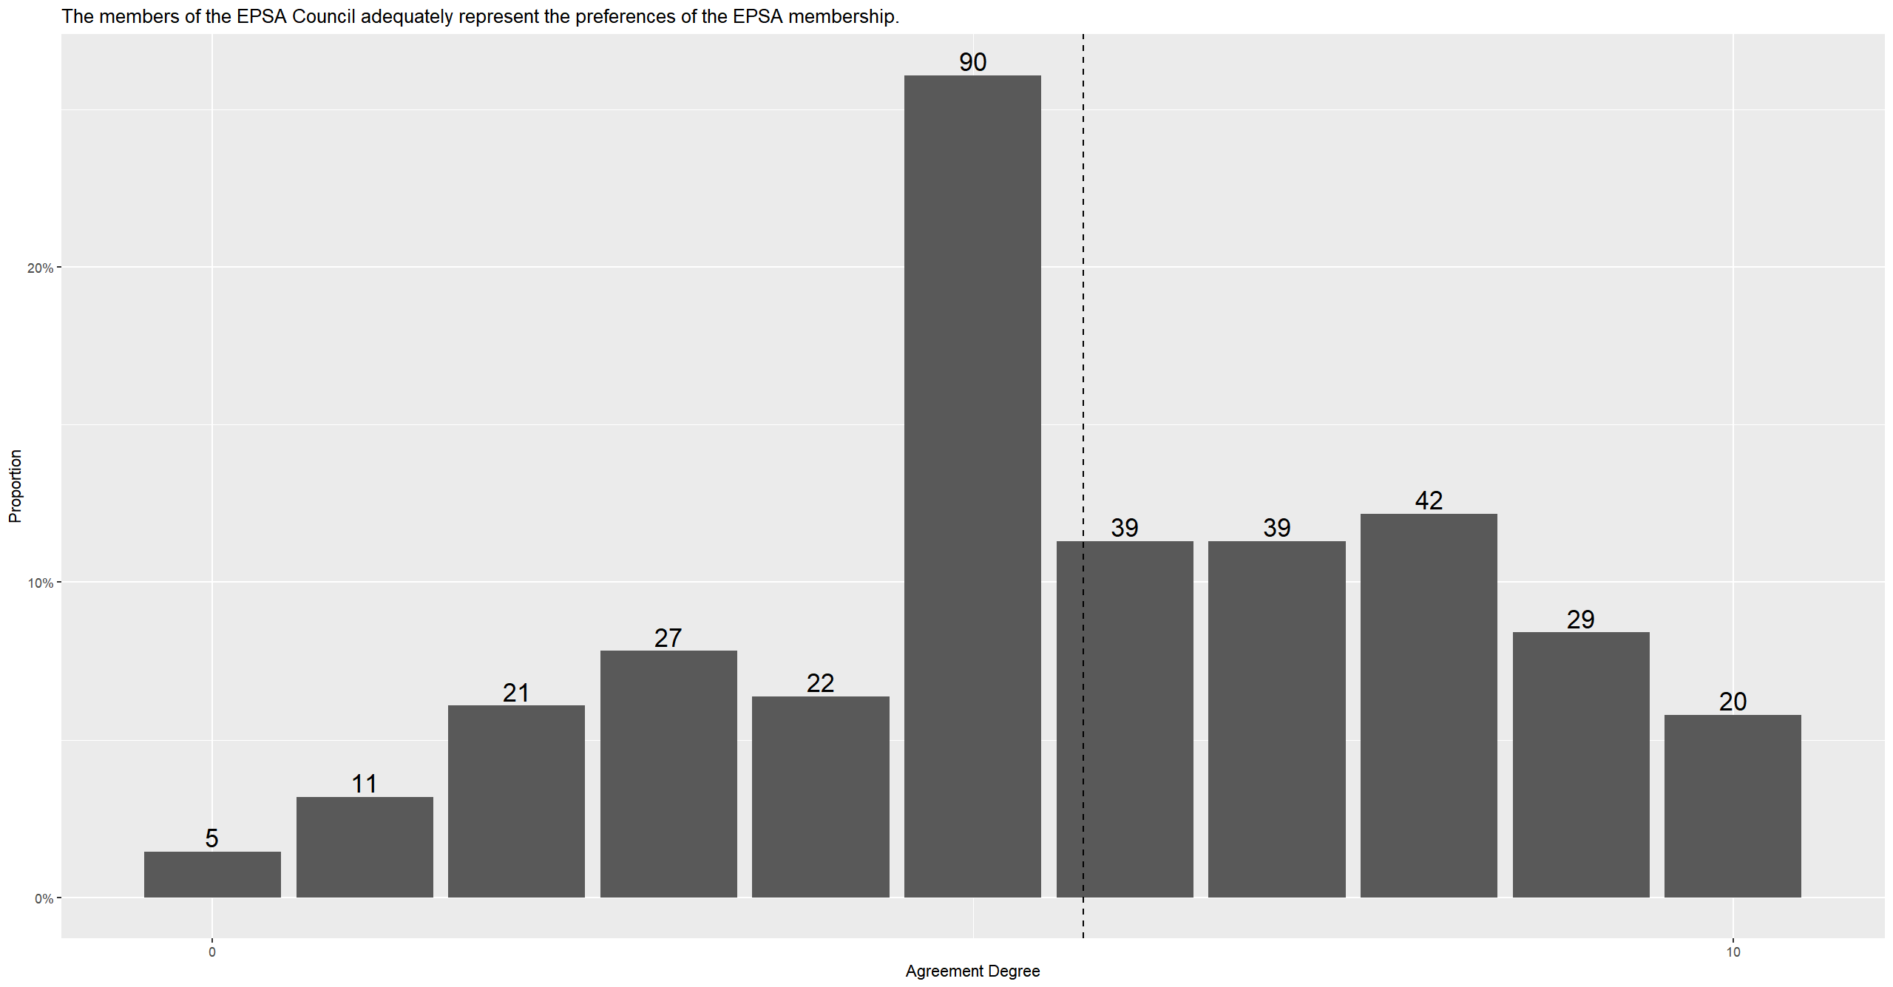
EPSA Council Represents Members’ Preferences

Slide 15
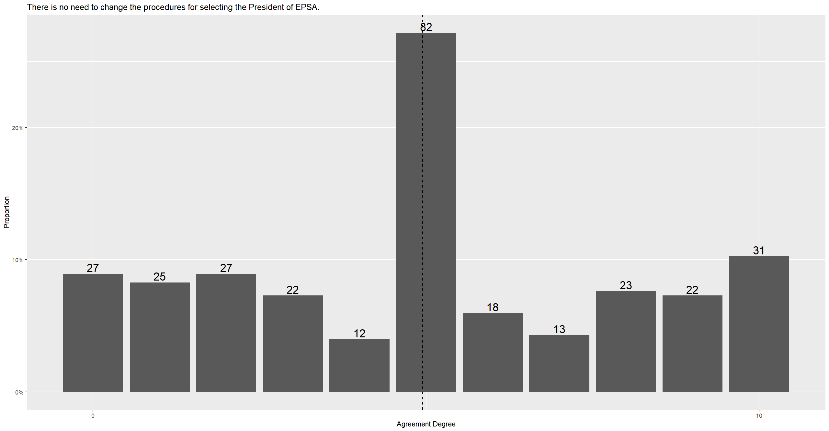
Selection of EPSA President

Slide 16
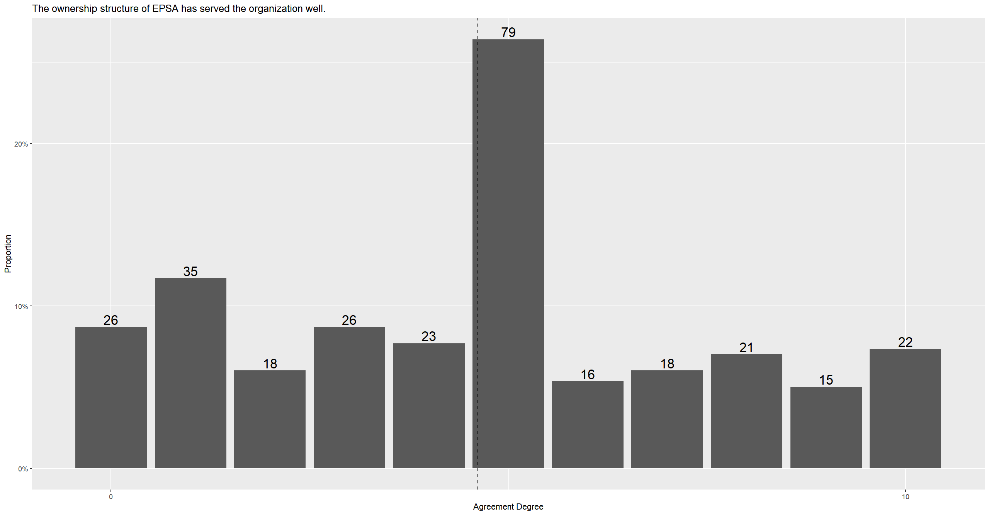
Ownership Structure of EPSA

Slide 17
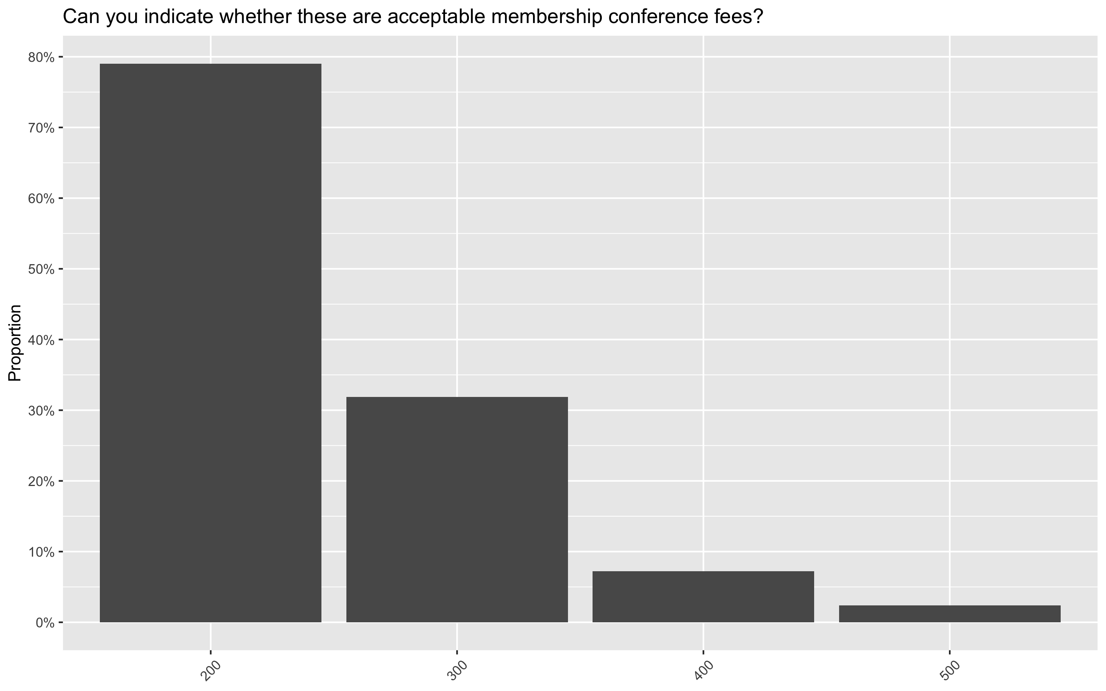
Membership Fees

Slide 18
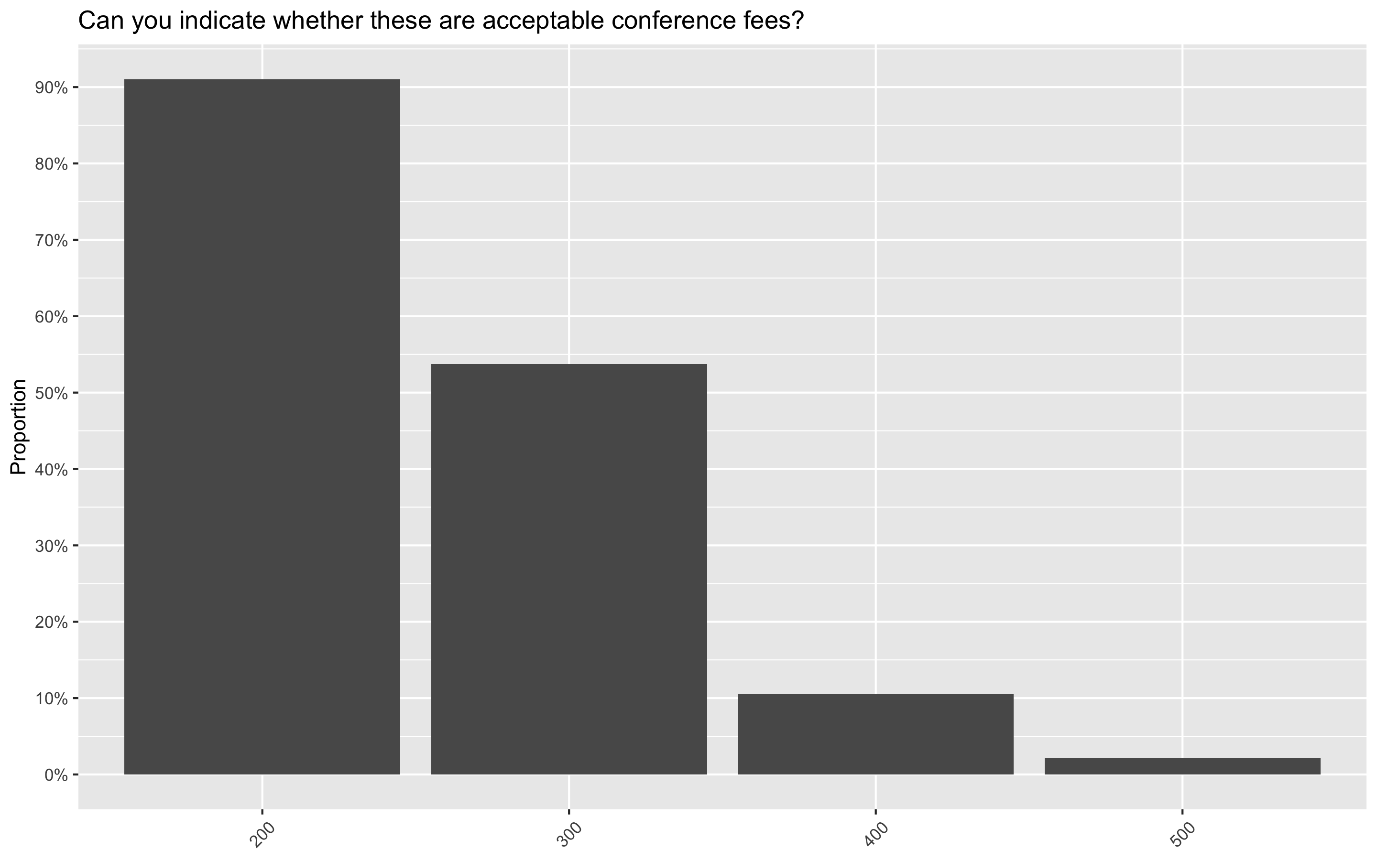
Conference Fees

Slide 19
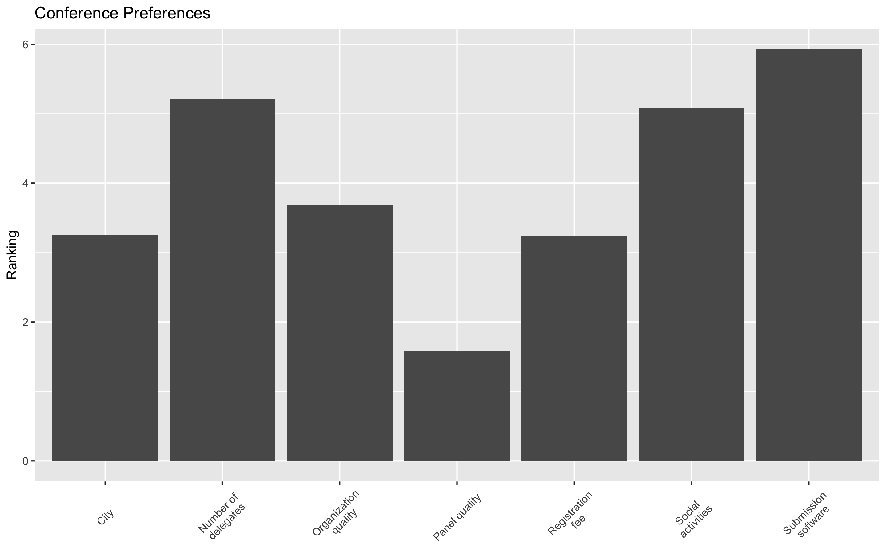
Ranking Conference Features

Slide 20
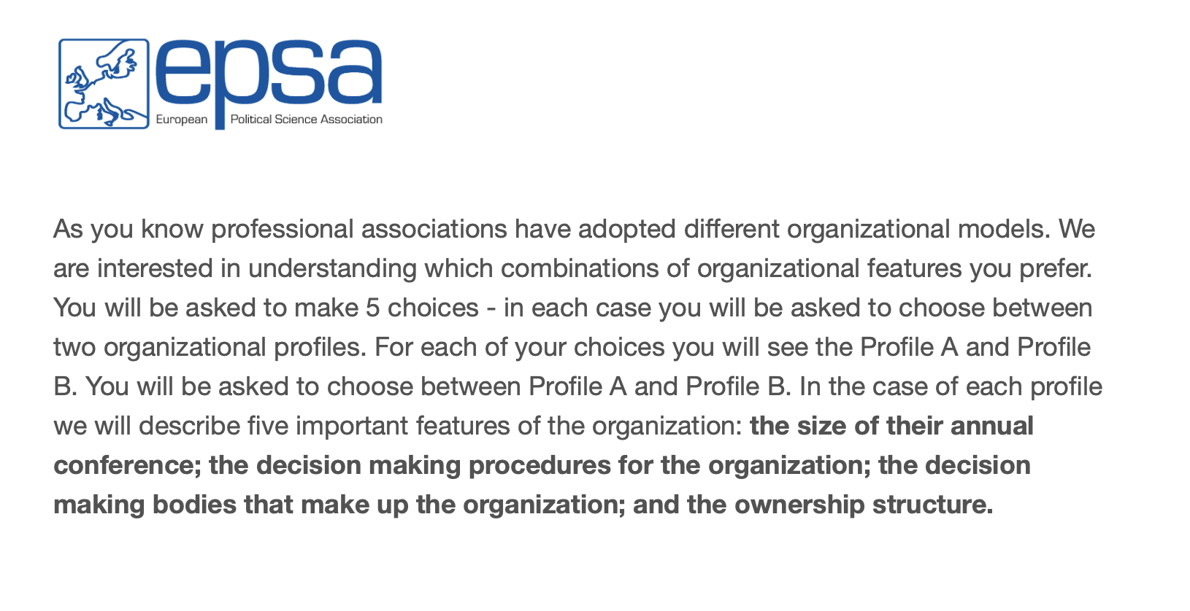
Conjoint Framing

Slide 21
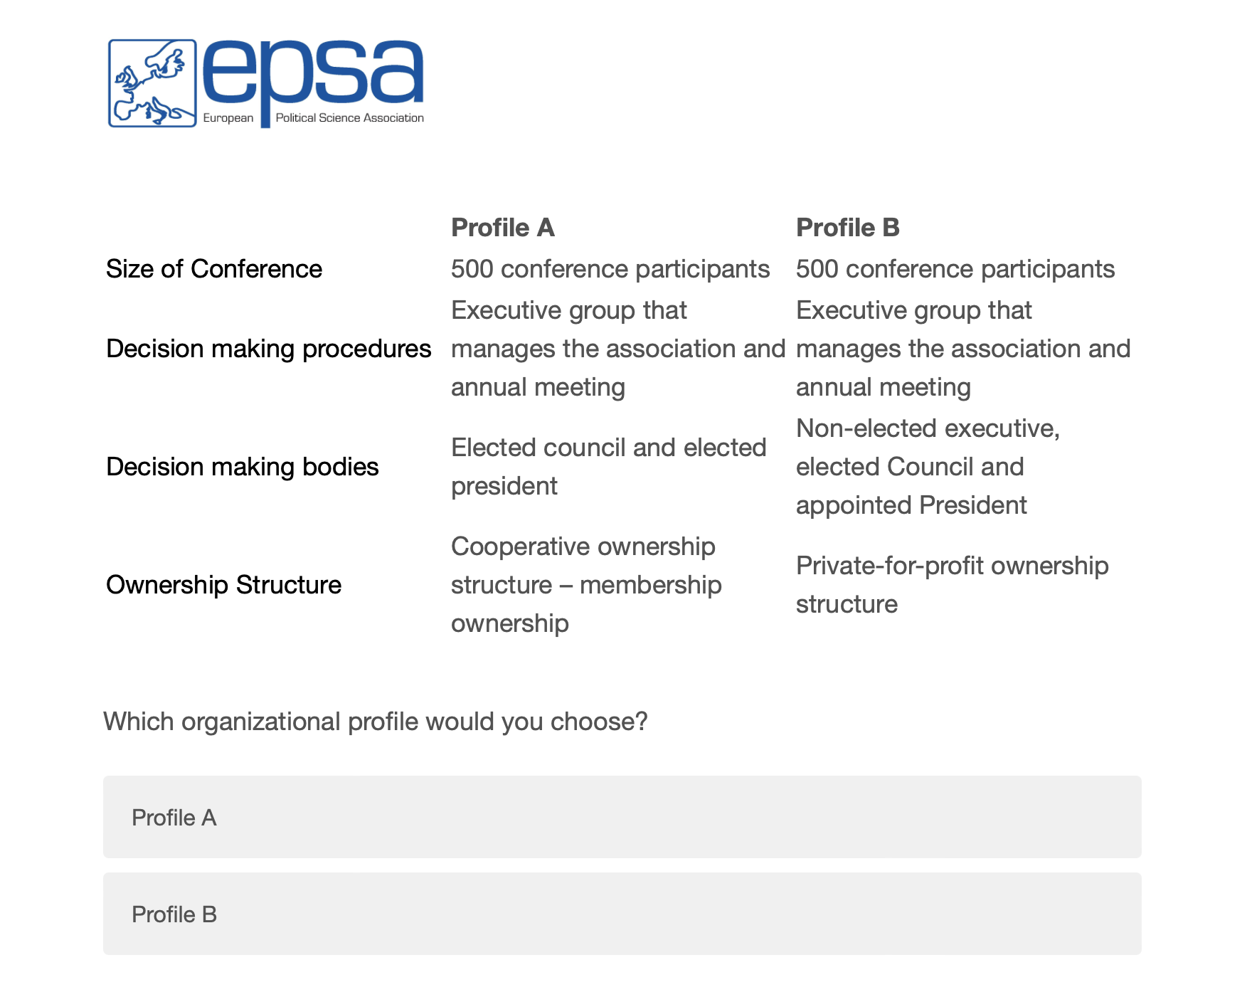
Conjoint Choice Screen

Slide 22
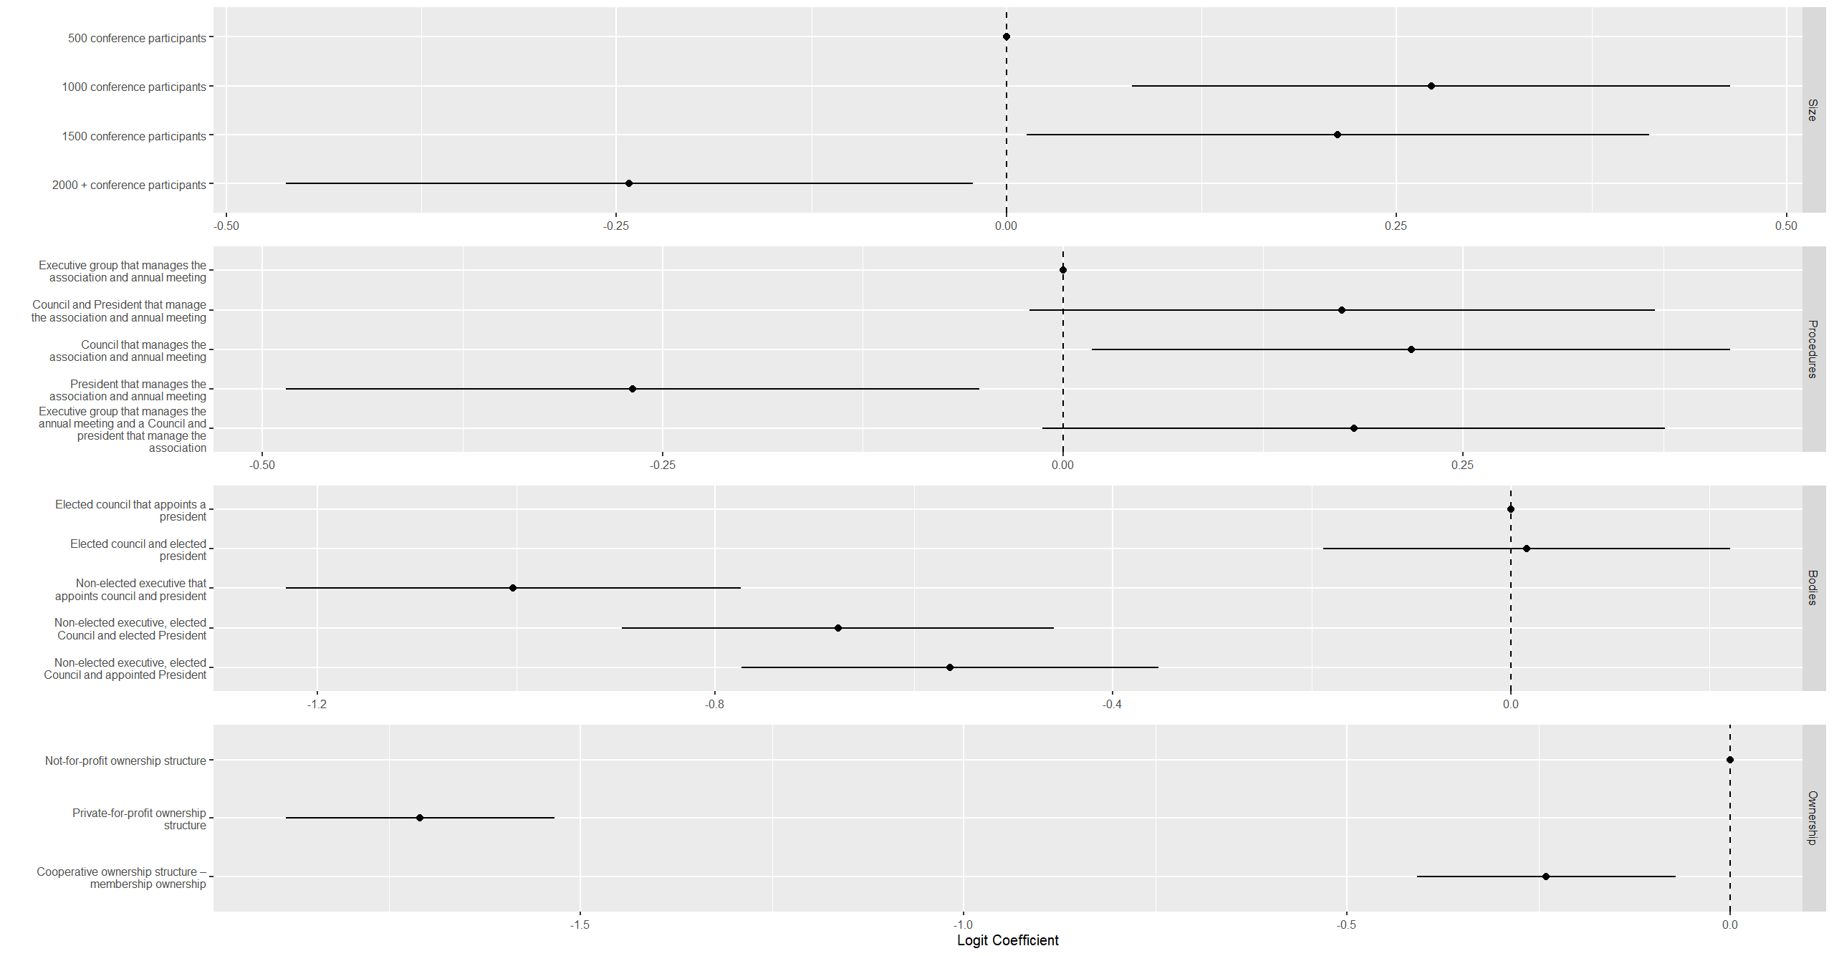

Slide 23
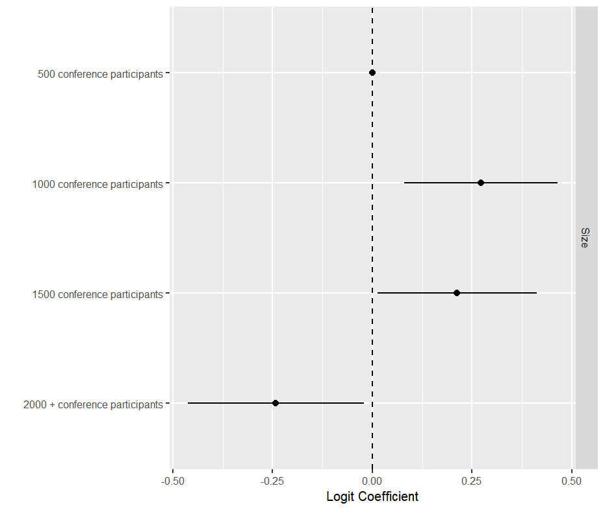
Conference Size

Slide 24
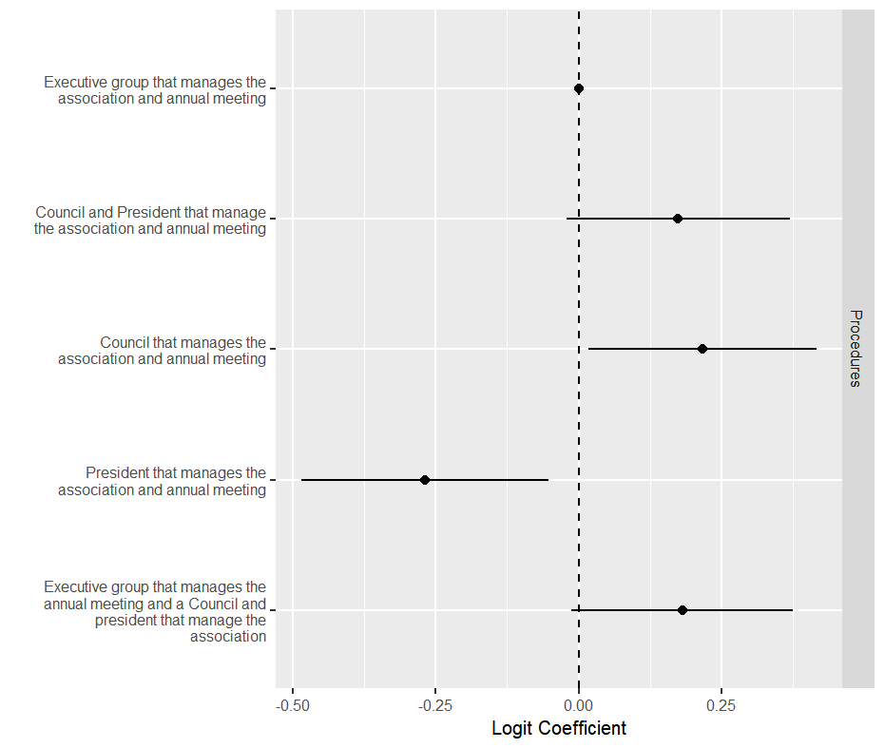
Association Procedures

Slide 25
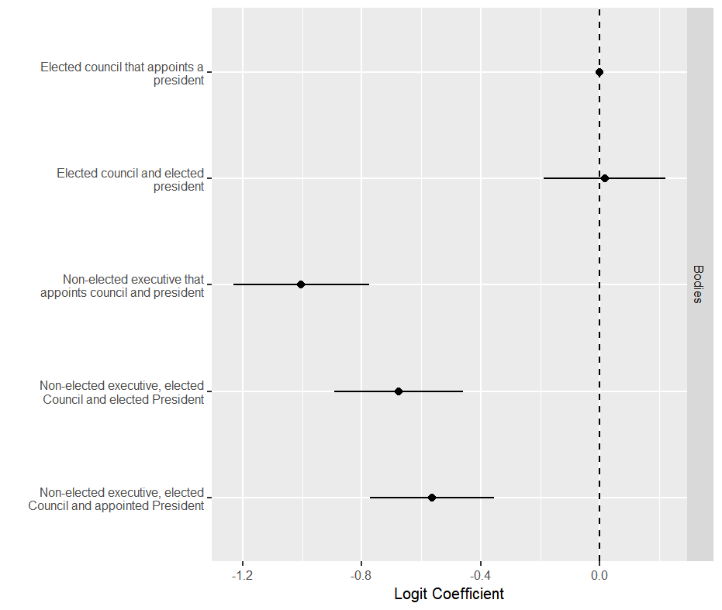
Appointment of Association Bodies

Slide 26
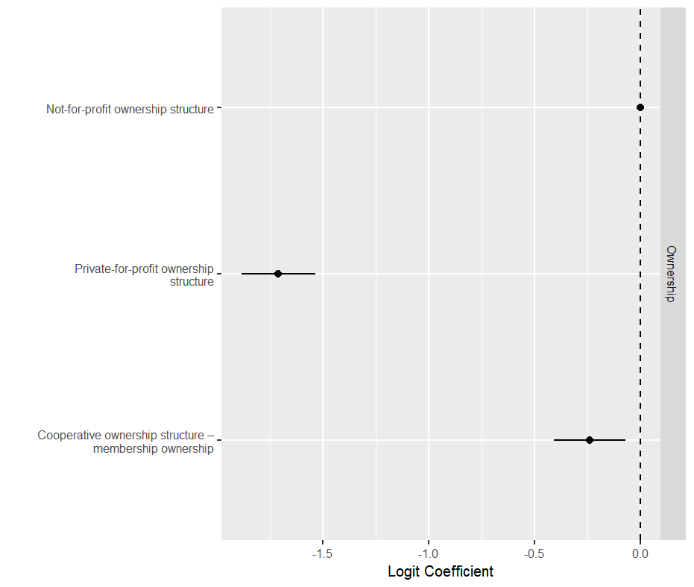
Association Ownership

Slide 27
Delegate Willingness to Invest
21% of delegates indicated an interest in investing in an EPSA-like entity
Remaining respondents indicated no, don’t know or gave no answer
Estimated average willingness to pay:
€555 (truncated at the maximum bid)
€1050 (truncated at the maximum bid with adjustment`)

Slide 28
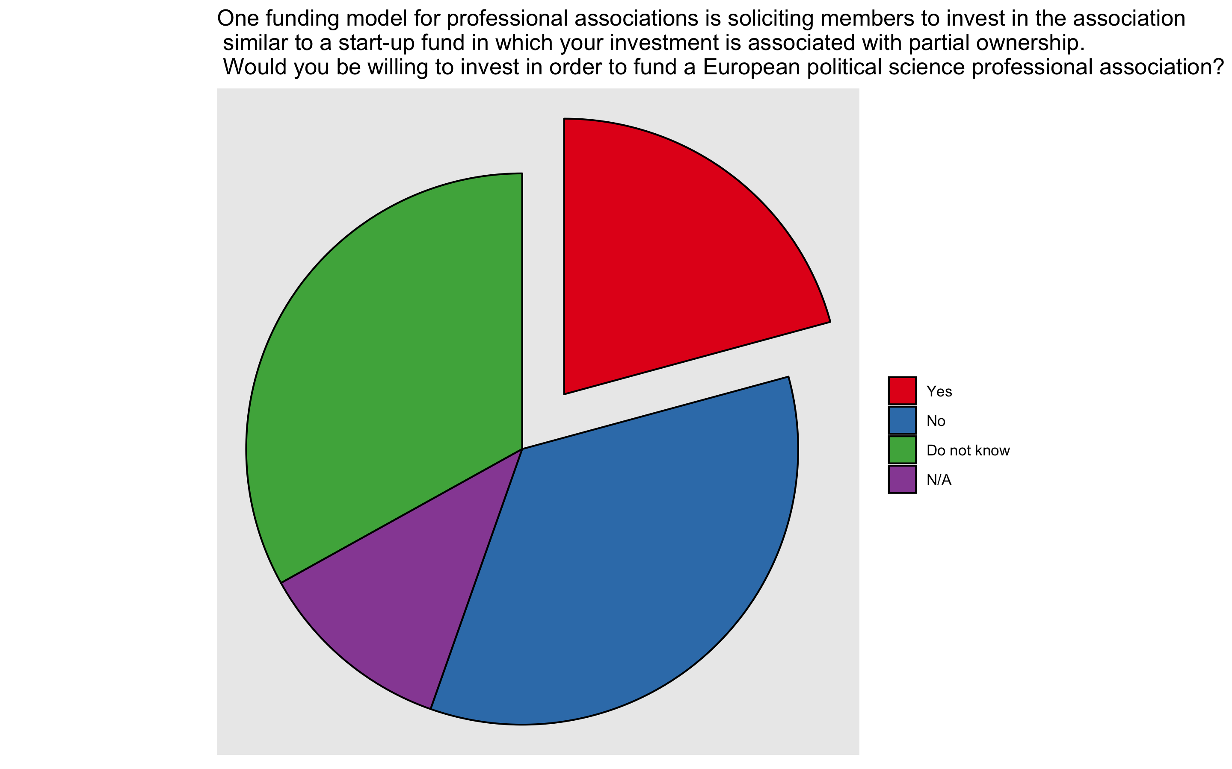
Willingness to Invest in EPSA

Slide 29
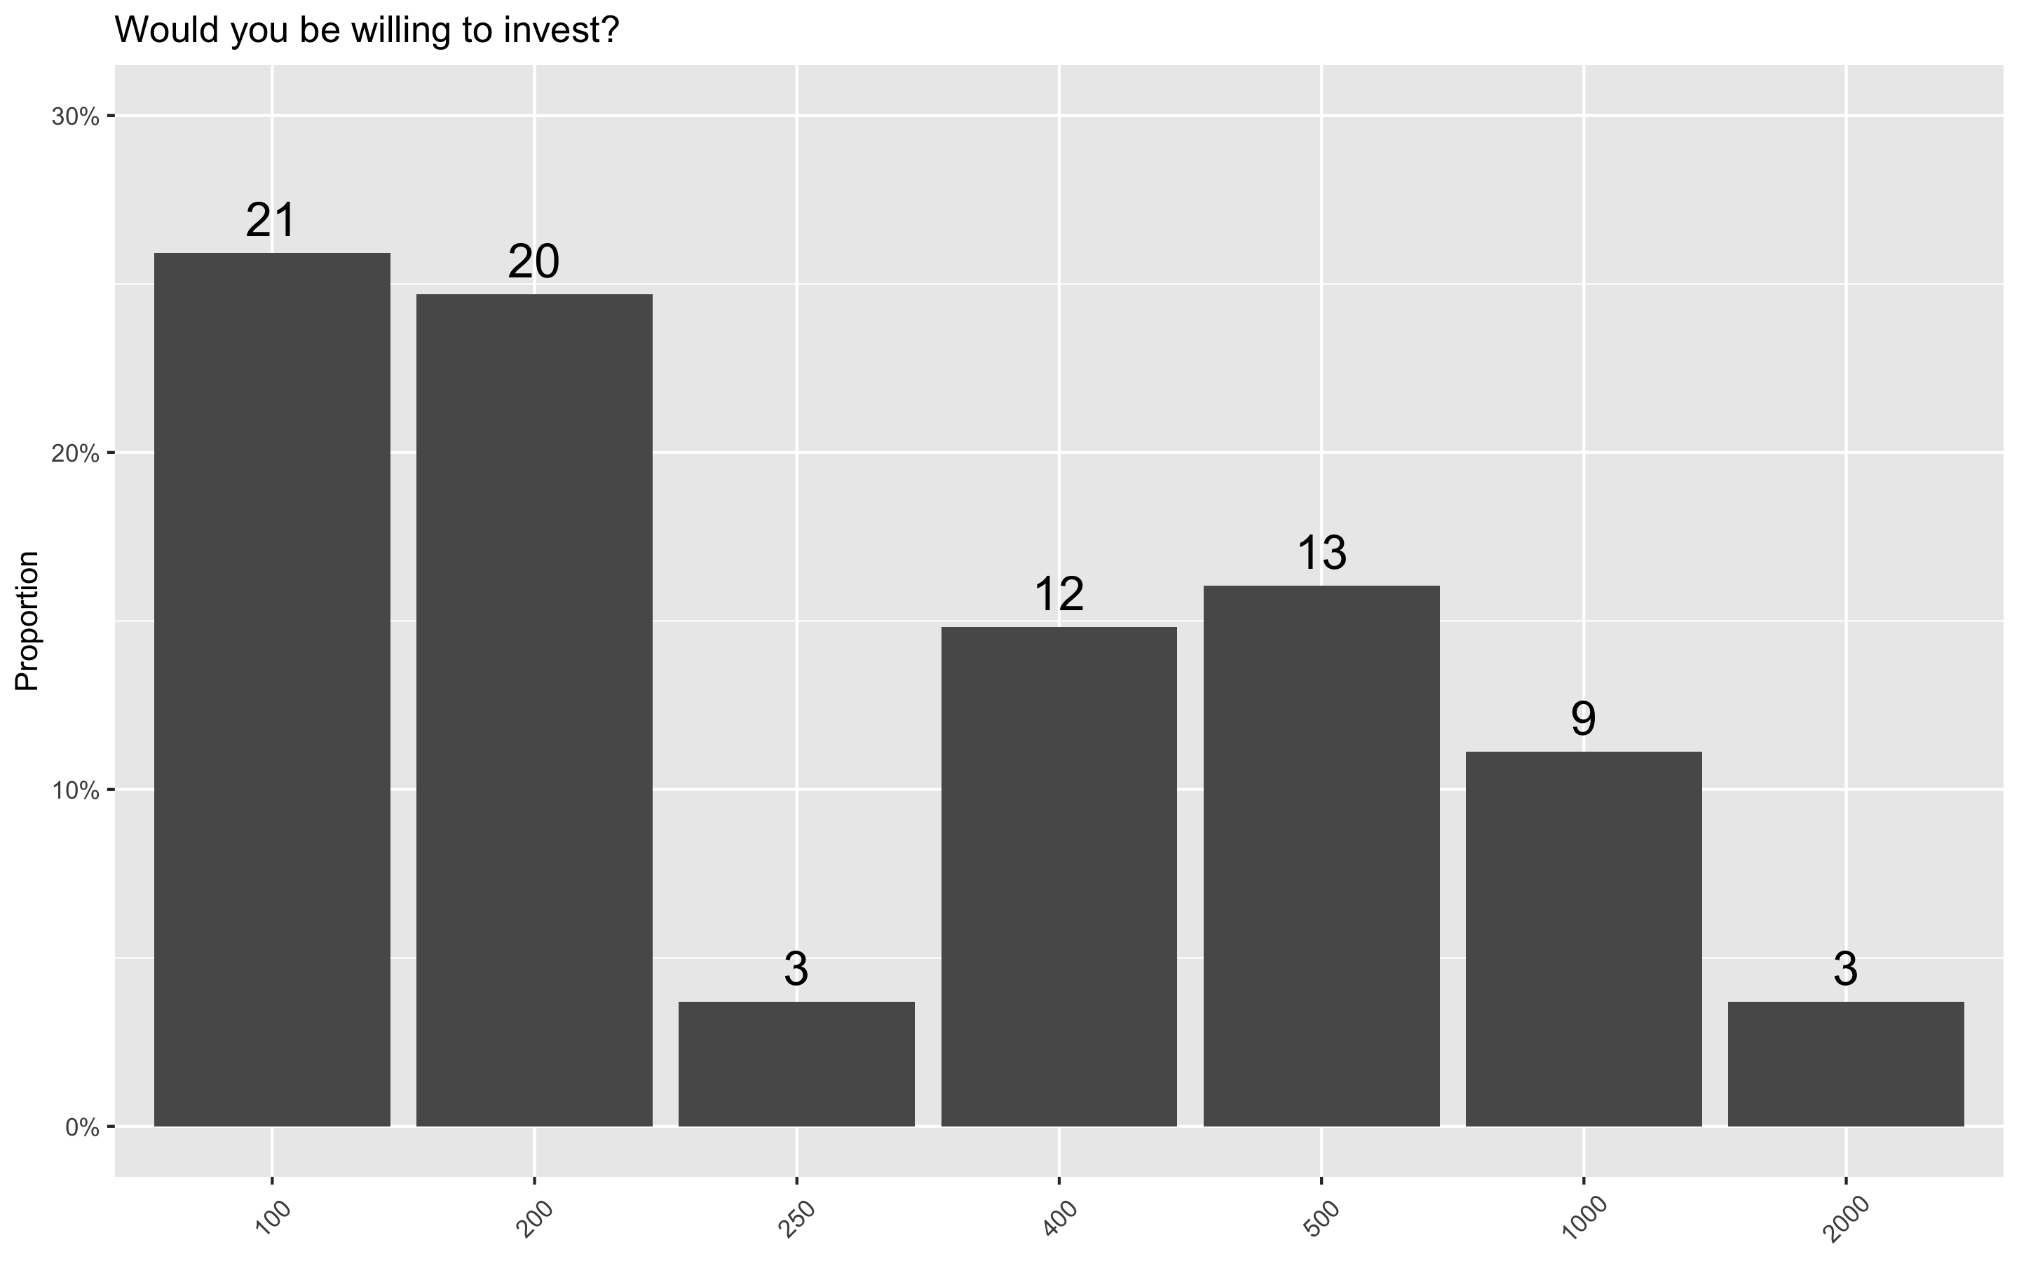
Willingness to Invest in EPSA: Amounts

Slide 30

EPSA Diversity

Slide 31
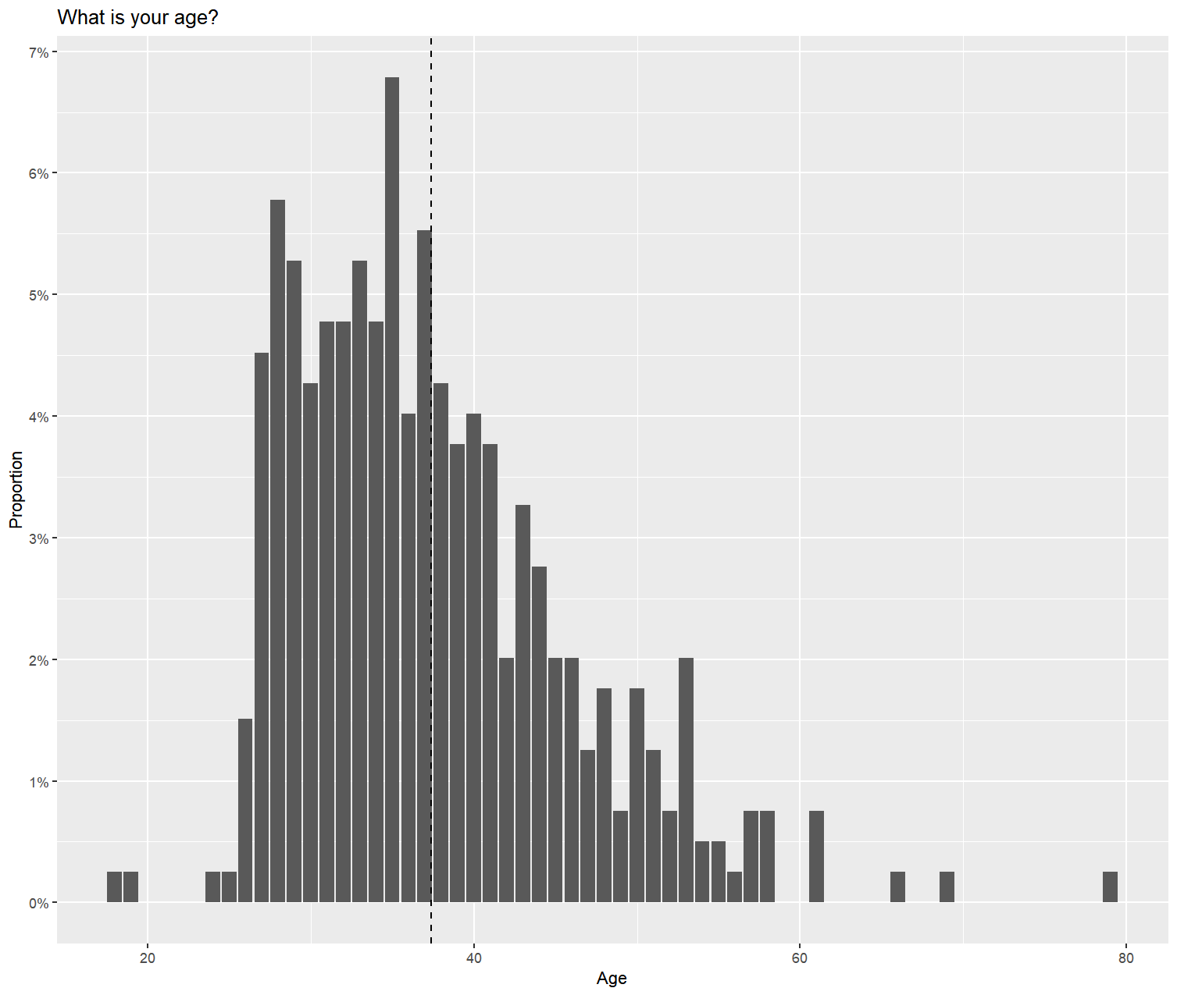
Age Composition of EPSA Meeting Attendees

Slide 32
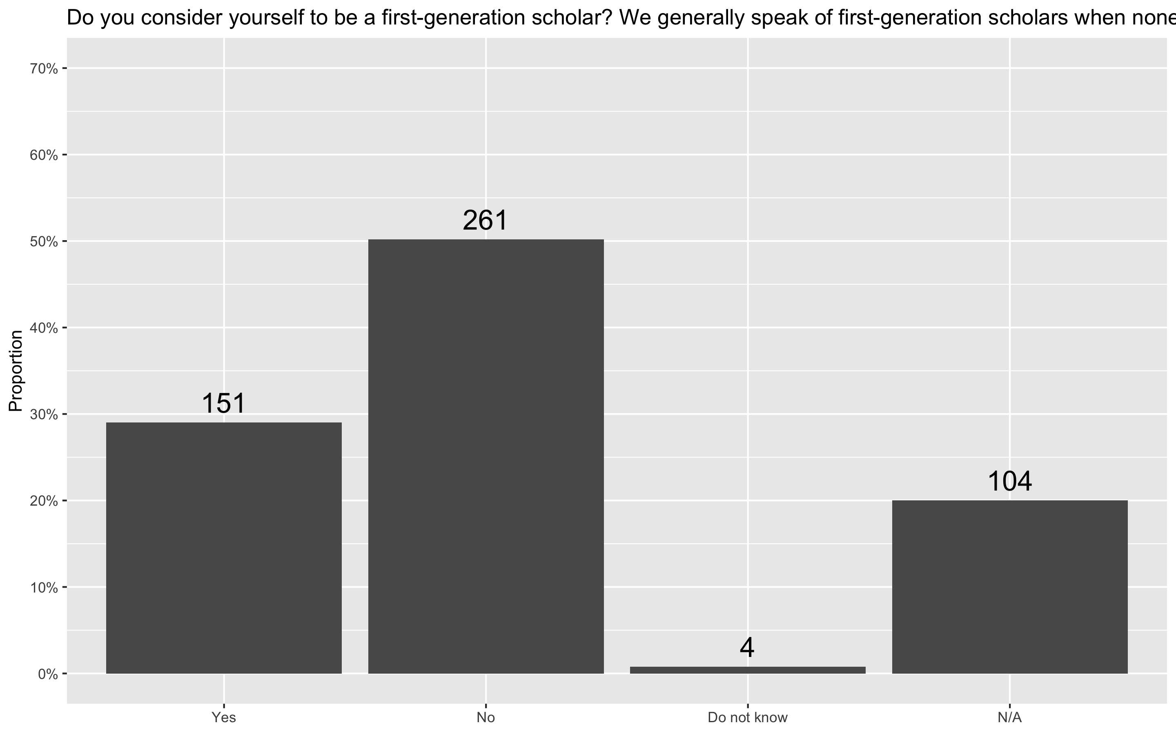
First Generation Scholar

Slide 33
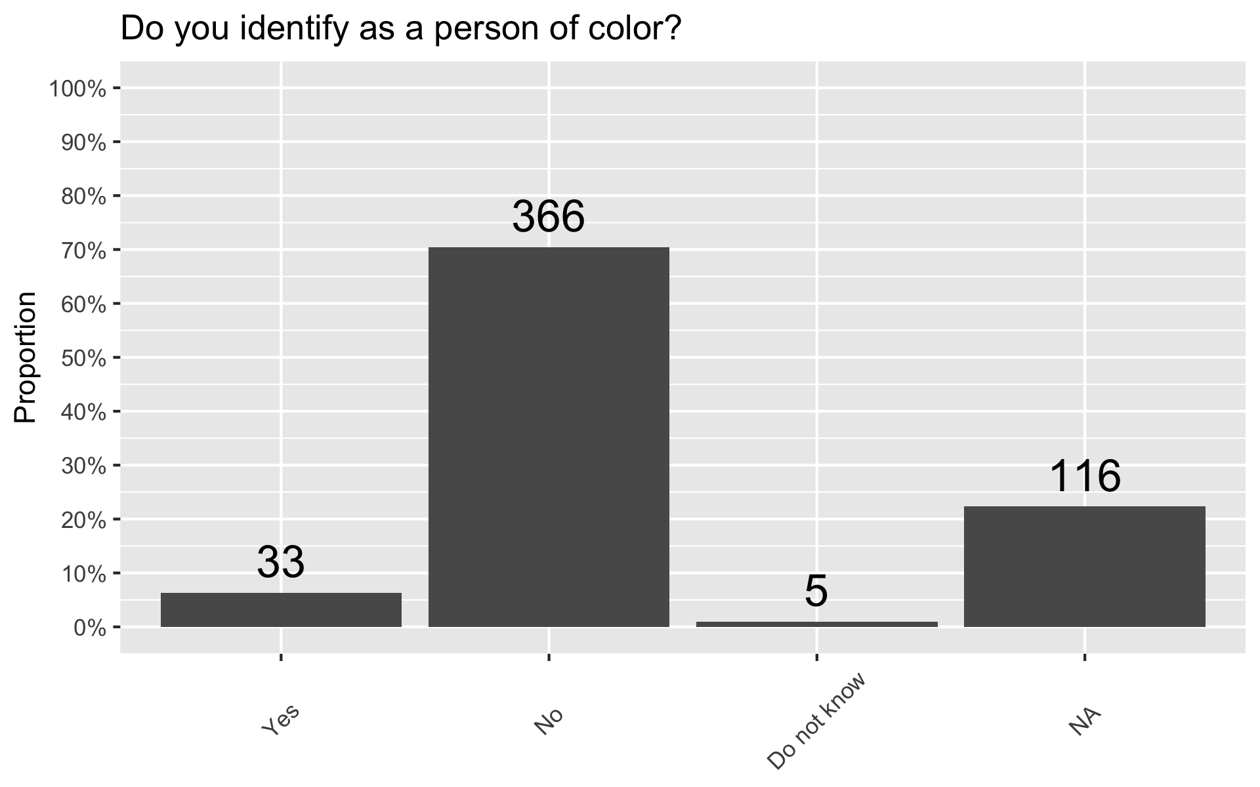
Race and Ethnicity

Slide 34
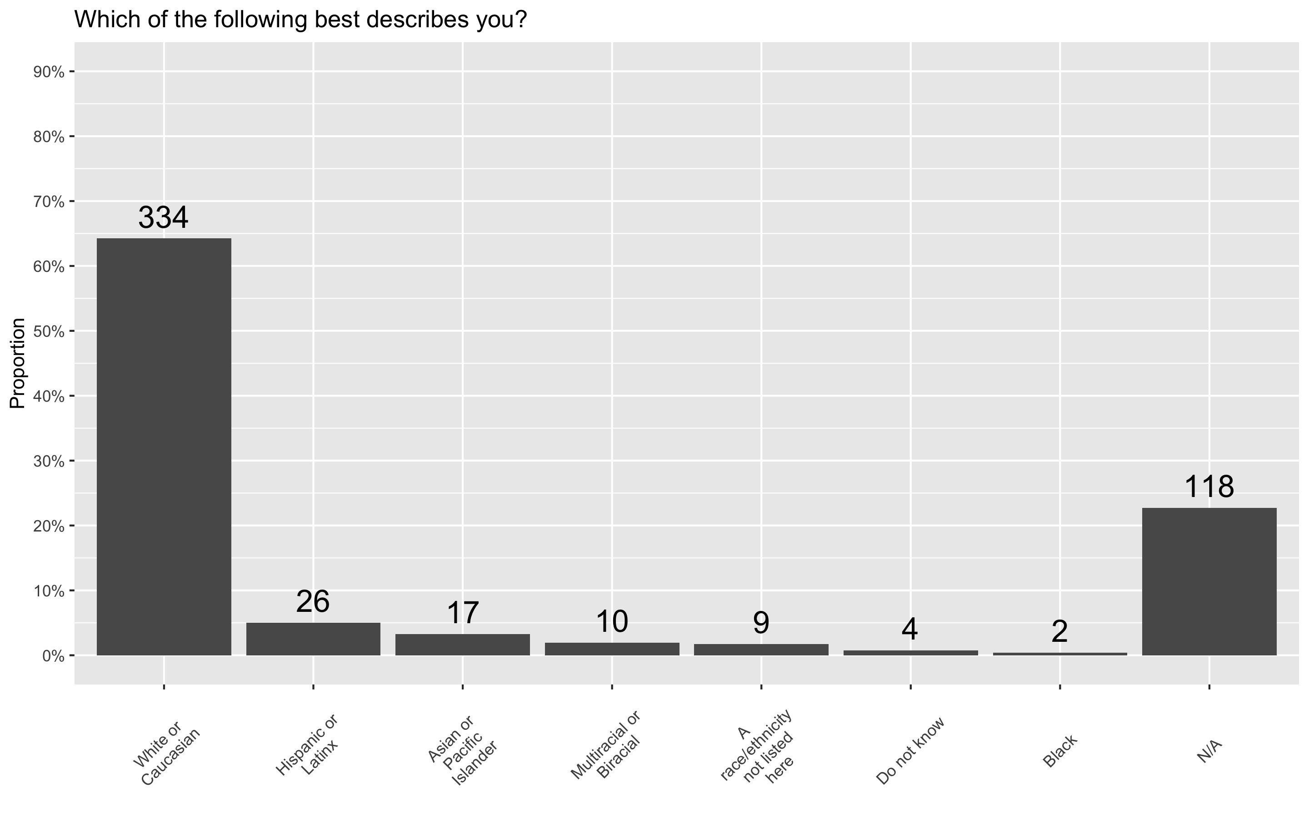
Race and Ethnicity

Slide 35
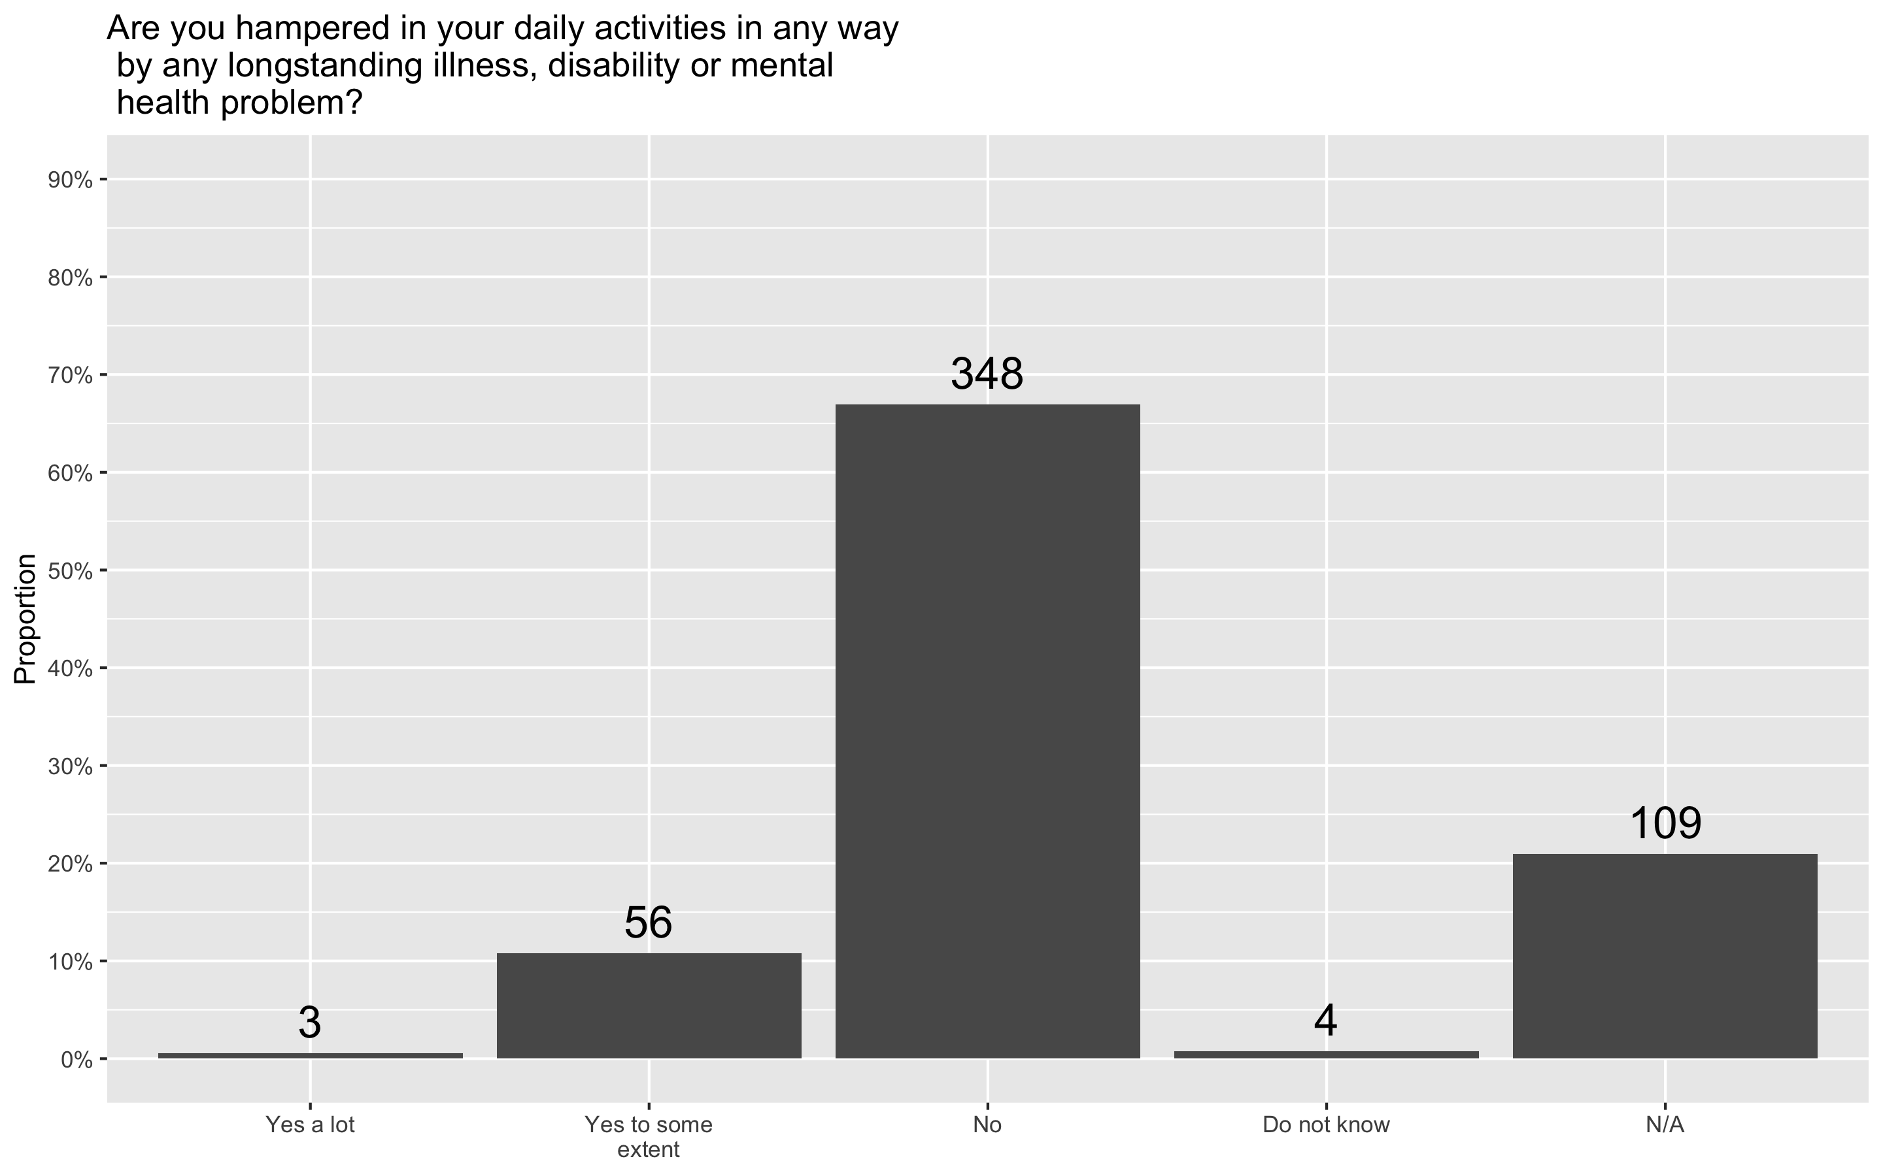
Disability

Slide 36
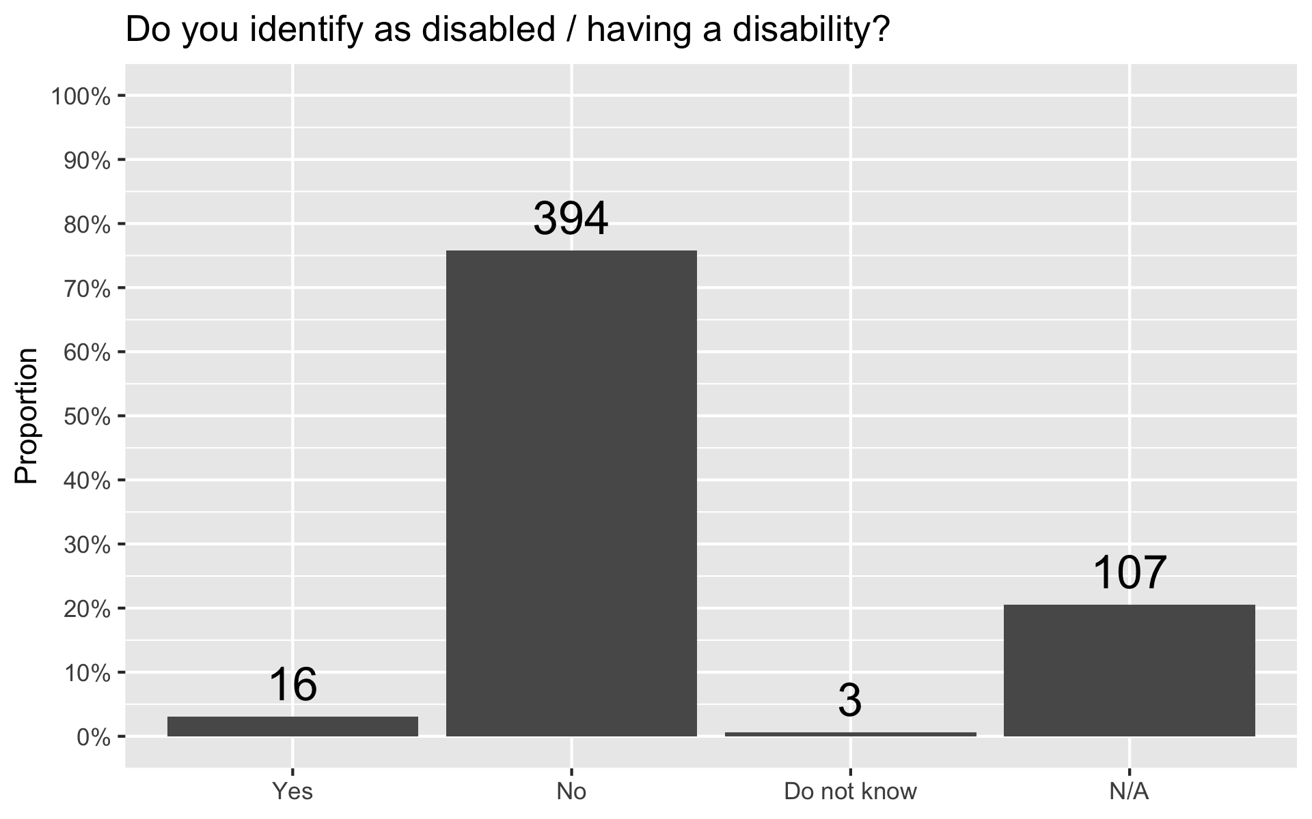
Disability

Slide 37
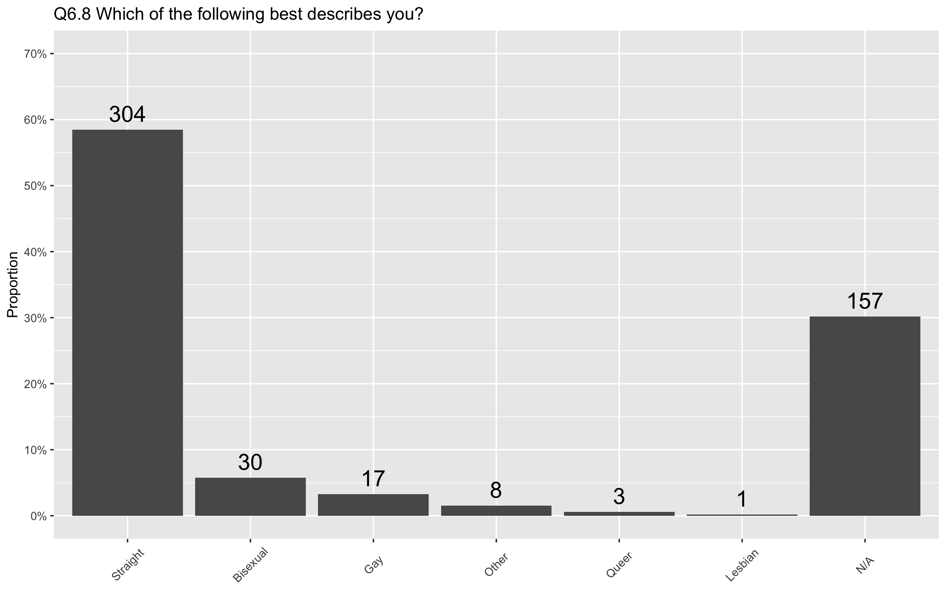
Gender Identity

Slide 38
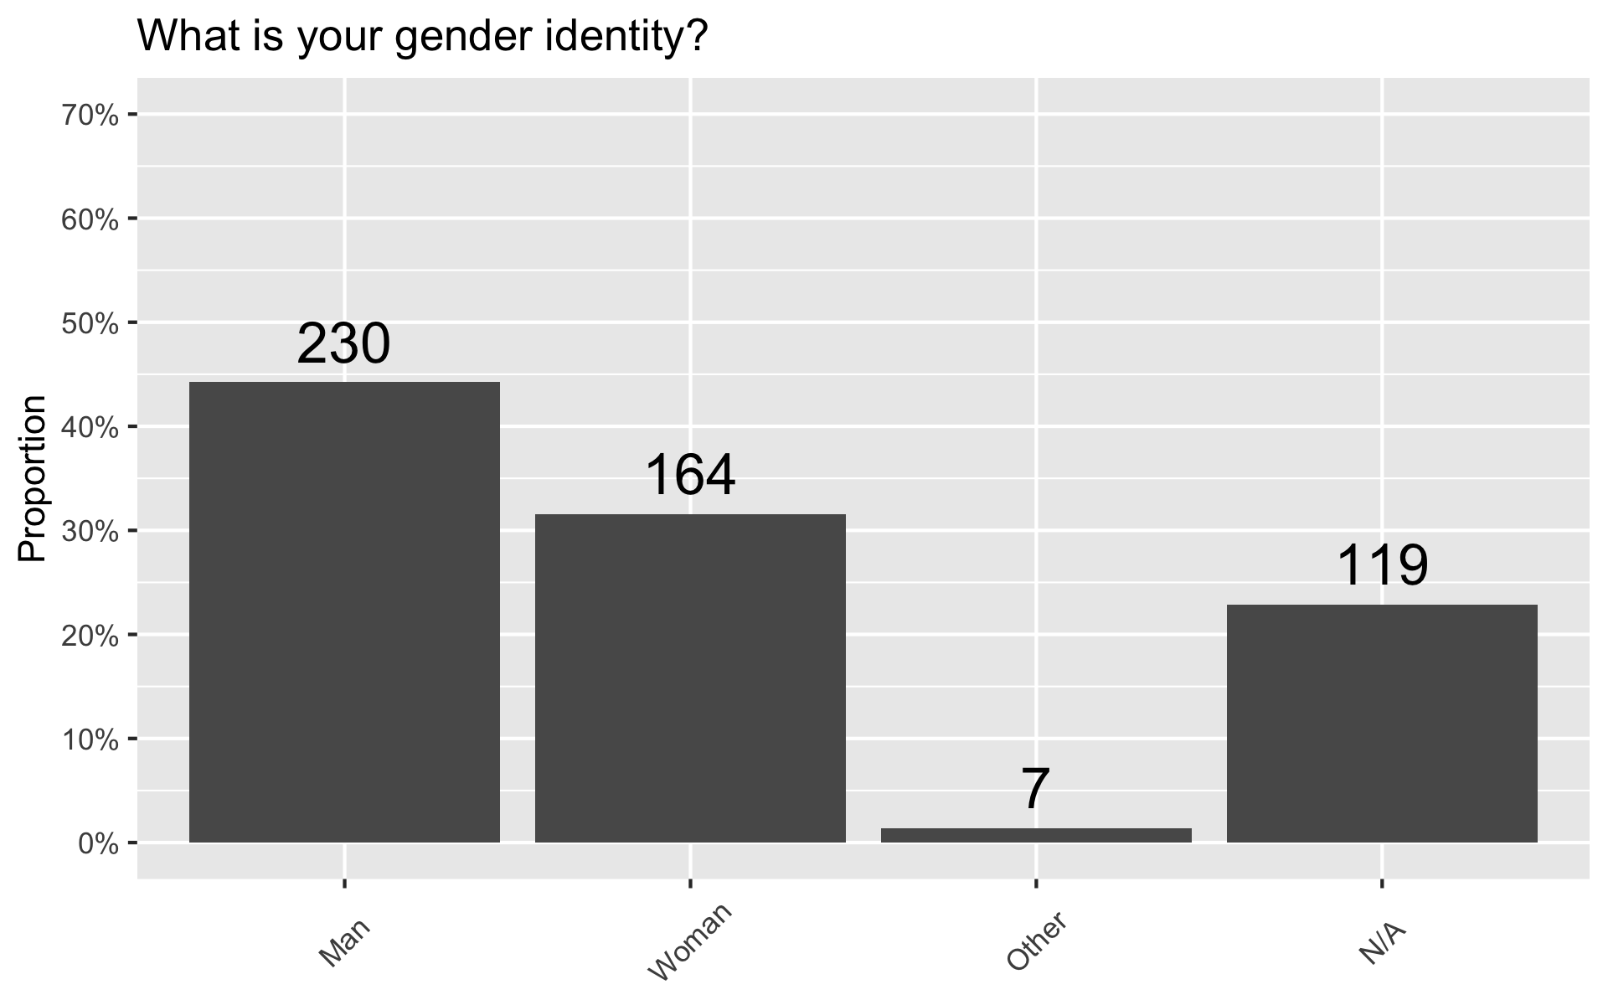
Gender Identity

Slide 39
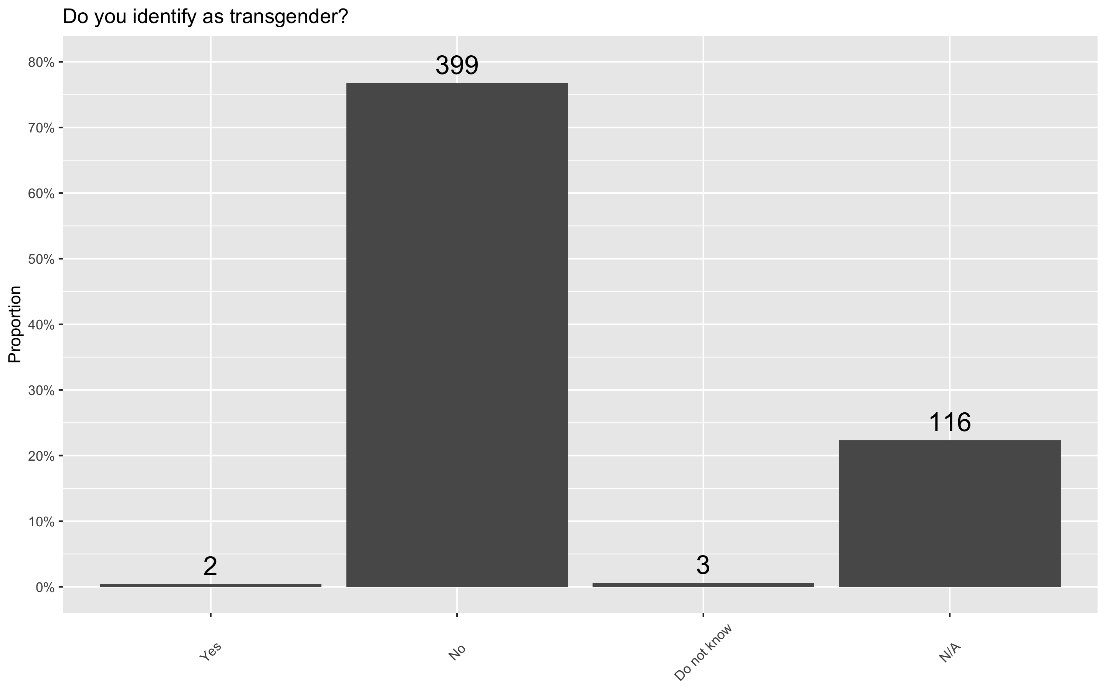
Gender Identity

